Slide 1






Generative AI Developing Applications Python OpenAI
Introduction to Large Language Models (LLM) and OpenAI
Xavier Morera
Helping developers create epic applications
www.xaviermorera.com / www.bigdatainc.org / www.lupo.ai

Slide 2

Life Before LLMs...

Slide 3


Go g[e
What time is it
X
••••••
•••
limages
In Costa Rica
With seconds
Now
Videos
Ct
In the adriatic sea
lnJST rn
EST
All filters ,..
Tools
SafeSearch ,..
About 25,220,000,000 results (O.48 seconds)
15:15
Tuesday, September 12, 2023 (CST) Time in Cartago Province, Concepcion
Feedback
a liime.is
https.://time.is :
Time.is - exact time, any tiime zone
7 million locations, 57 languagies. synchronized with atomic clock time.
Exact Ume, any time zone
7 million locations, 57 languages, synchronized wi h atomic clock ...
Clock
liime.is. Your clock is 8 minutes and 16.0 seconds belhind ...
Eastern Time
From 5 November 2023: UTC -5 / Eastern Standard Time (EST ...
Time in United States now
liime zone info for United States· Switched to UTC -4 /Ea.stem ...
More results from Ume.is »
People also ask
.•
Is it AM or PM?
V

Slide 4

Life with LLMs!

Slide 5

[]
Default (GPT-3.5)
L!J
Do I include a question mark inside or outside quotes?
, 1 The placement of a question mark in relation to quotation marks depends on the specific sentence structure and the punctuation involved. In American English,the g:eneral rule is to
place the question mark inside the quotation marks if the question mark is part of the quoted material, and outside the quotation marks if it applies to the entire sentence.
□ rb CJl
Here are some examples to illustrate this:
She asked, ¹¹ls it going to rain today?" (The question mark is inside the quotation marks because it is part of the quoted question.)
Did he really say,"I'll be there in five minutes"? (The question mark is outside the quotation marks because it appllies to the entire sentence, not just the quoted material.)
Who wrote the poem "The Road Not Taken''? (The question mark is outside the quotation
marks because it applies to the entire sentence, which is a question about the title of a poem.)
So, the placement of the question mark depends on whether it is part .of the quoted r
G Regenerate
Send a message
Free Research Preview.ChatGPT may produce inaccurate information about people. places, or facts. ChatGPT August 3 Version
?.

Slide 6
Large Language Models (LLM)

Slide 7


+ GP"J-3.5
[]
+: GPT-4 ■
P an an itinerary
for a fashion-focused exploration of Paris
Recommend a dish
to bring to a potluck
Write an email
requesting a deadline extension for my project
Suggest some names
for my cafe-by-day, bar-by-night business
Is ClhatGPT an LLM?
Free Research Preview.ChatGPT may produce inaccurate information about people. places, or facts. ChatGPT August 3 Version
?.

Slide 8


•
[]
Default (GPT-3.5)
Is ChatGPT an LLM?
Yes, ChatGPT is a Larg,e Language Model (LLM). It is based on the GPT-3.5 architecture, which stands for "Generative Pre-trained Transformer 3.5." LLMs like ChatGPT are designed to understand and generate human-like text based on the input they receive. They have a wide range of applications, including natural language understanding,text generation, and various forms of human-computer interaction.
□ cCJ CJl
G Regenerate
Send a message
Free Research Preview.ChatGPT may produce inaccurate information about people. places, or facts. ChatGPT August 3 Version
?.

Slide 9
Yes, I am a language model, often referred to as a Large Language Model (LLM). Specifically, I'm based on the GPT-
3.5 architecture developed by OpenAI. I'm designed to understand and generate human-like text based on the input I receive. How can I assist you today?

Slide 10



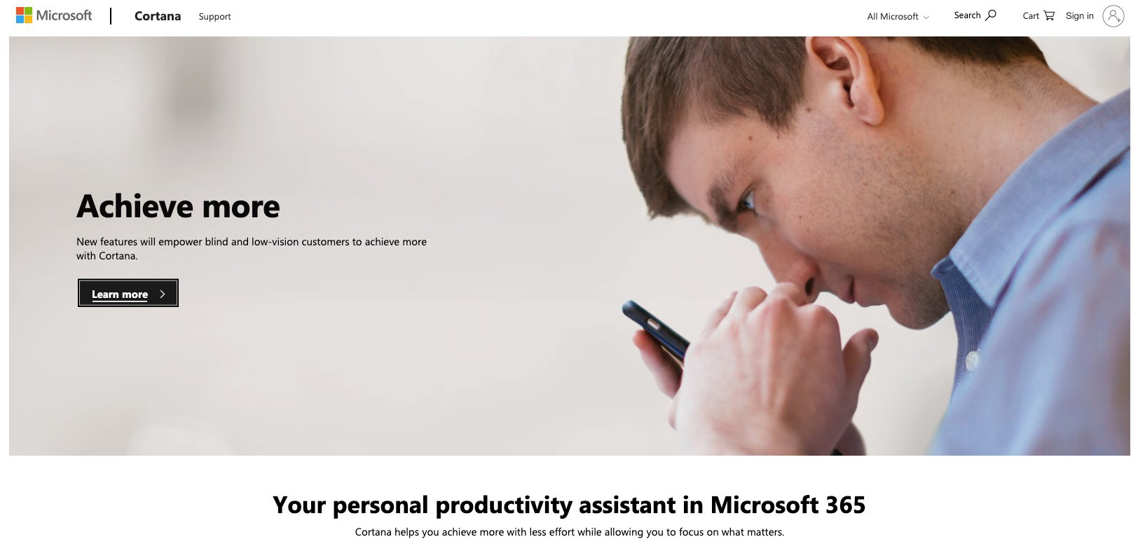

Slide 11



ELIZA: a very basic Rogerian psychotherapist chatbot
Talk to Eliza by typing your questions and answers in the input box.
> Hello, I am Eliza. I'll be your therapist today.
/,
I first encountered ELIZA on the Tandy/Radio Shack computers that made up the first computer lab in the junior high school where I taught in the 1970s. By then, ELIZA was a software tween herself.
This early natural language processing program had been written in the mid-1960s at the MIT Artificial Intelligence Laboratory by Joseph Weizenbaum. It supposedly had been created to demonstrate how superficial human to computer communications was at that time. But, when it was put on personal computers, humans found it quite engaging.
WHAT DOES ELIZA DO?
Using "'pattern matching" and substitution methodology, the program gives canned responses that made early users feel they were talking to someone who understood their input. The program was limited by the scripts that were in the program. (ELIZA was originally written in MAD-SliR.) Many variations on the original scripts were made as amateur coders played around with the fairly simple code.
Perhaps the most well known variation was called DOCTOR. This was made to respond like a Rogerian QSY.Chotheragist. In this instance, the therapist "reflects" on questions by turning the questions back at the patient.
ELIZA was one of the first chatterbots (later clipped to chatbot). It was also an early test case for the Turing Test, a test of a machine's ability to exhibit intelligent behavior equivalent to, or indistinguishable from, that of a human. By today's standards ELIZA fails very quickly if you ask it a few complex questions.

Slide 12

Large Language Models (LLM)

Slide 13


Gmail
Images
•••
••••••
0.
chatgpt
X
"'
r_{L}::".'
0
0
Q.
Q.
Q.
Q.
Q.
Q.
Q.
Q.
chatgpt trained on copyright data
chatgpt llm chatgpt chatgpt 4 chatgpt app
chatgpt login chatgpt detector chat gratis chatgpt espaliol chatgpt que es
Google Search
ll'm Feeling Lucky
Costa Rica
Report inappropriate predictions
About
Advertising
Business
How Search works
Privacy
Terms
Settings

Slide 14

Large Language Models (LLMs)
Built on advanced neural network architectures
Processing and generating natural language
Ability to analyze and comprehend text data Tasks
Language translation
Text summarization
Question answering
Creative writing
LLMs

Slide 15
Large Language Models (LLMs)
Immense scale
Number of parameters
Amount of training data
Learn from vast amounts of text
Patterns, grammar, semantics, and even nuances of human language
The training process
Exposes the model to diverse sentences
Enable it to learn to predict the next word
Based on the context it has seen
LLMs

Slide 16

LLMs
Where did LLMs come from?

Slide 17
The Journey to Large Language Models

Slide 18

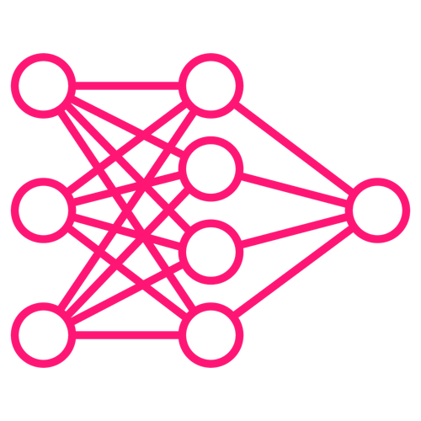



The Journey to Large Language Models
Early Language Models
Neural Language Models Attention Mechanisms BERT and Pre-training
GPT Series

Slide 19






The Journey to Large Language Models
Zero-Shot and Few-Shot Learning
Fine-Tuning and Specialization Multilingual and Cross-Lingual Models Ethical and Bias Concerns
Future Directions

Slide 20
Benefits, Challenges, Applications, Limitations, and Ethical Considerations

Slide 21
Benefits and Challenges
Benefits
Natural language understanding and generation
Automation of language tasks Accessibility
vs
Challenges
Bias and fairness Misinformation Ethical dilemmas

Slide 22

Applications
Content generation
Chat-bots and virtual assistants Language translation
Code generation
Sentiment analysis

Slide 23

Limitations
Lack of causality
Scale dependency
Interpretable representations Lack of true understanding Incorrect information Dependency on data

Slide 24

Responsible AI Usage

Slide 25

Bias Mitigation and Transparency
Bias identification and removal
Algorithmic auditing Transparency in training data

Slide 26

Ethical Considerations
Authenticity and attribution
Ownership and copyright

Slide 27

User Awareness and Education
Informed interaction
Critical engagement

Slide 28

Collaborative Efforts
Global ethical frameworks
Stakeholder engagement

Slide 29
A Little Bit About OpenAI

Slide 30

@OpenAI
Research v
API v
ChatGPT v
Safety
Company v
Search Log in )'I I Get started )'I I
Introducing OpenAI
OpenA:I is a non-profit artificial inteUigence research company. Our goal is to advance digital intelligence in the way that is most likely to benefit humaniity as a whole, unconstrained by a need to generate financial return. Since our research is free from financial obligations., we can better focus on a positive human impact.
ll!ustration:Justin Jay Wang

Slide 31

Pioneering Research and Development
Groundbreaking research and development
LLMs serving as a significant milestone
Models like the GPT series
Have propelled LLMs to the forefront of AI innovation
Show OpenAI's commitment to pushing the boundaries of natural language processing and understanding

Slide 32

Responsible AI Leadership
Actively engaged with concerns
- Related to bias, misinformation, and ethical usage
Seeks to set standards for responsible AI deployment

Slide 33

Impact on the Field of LLMs
The GPT series has demonstrated the potential of LLMs
Content generation, chat-bots, and code assistance
Have influenced
Research directions, industry applications
The public's perception of AI capabilities

Slide 34

Demo
ChatGPT Demo

